Slide 1
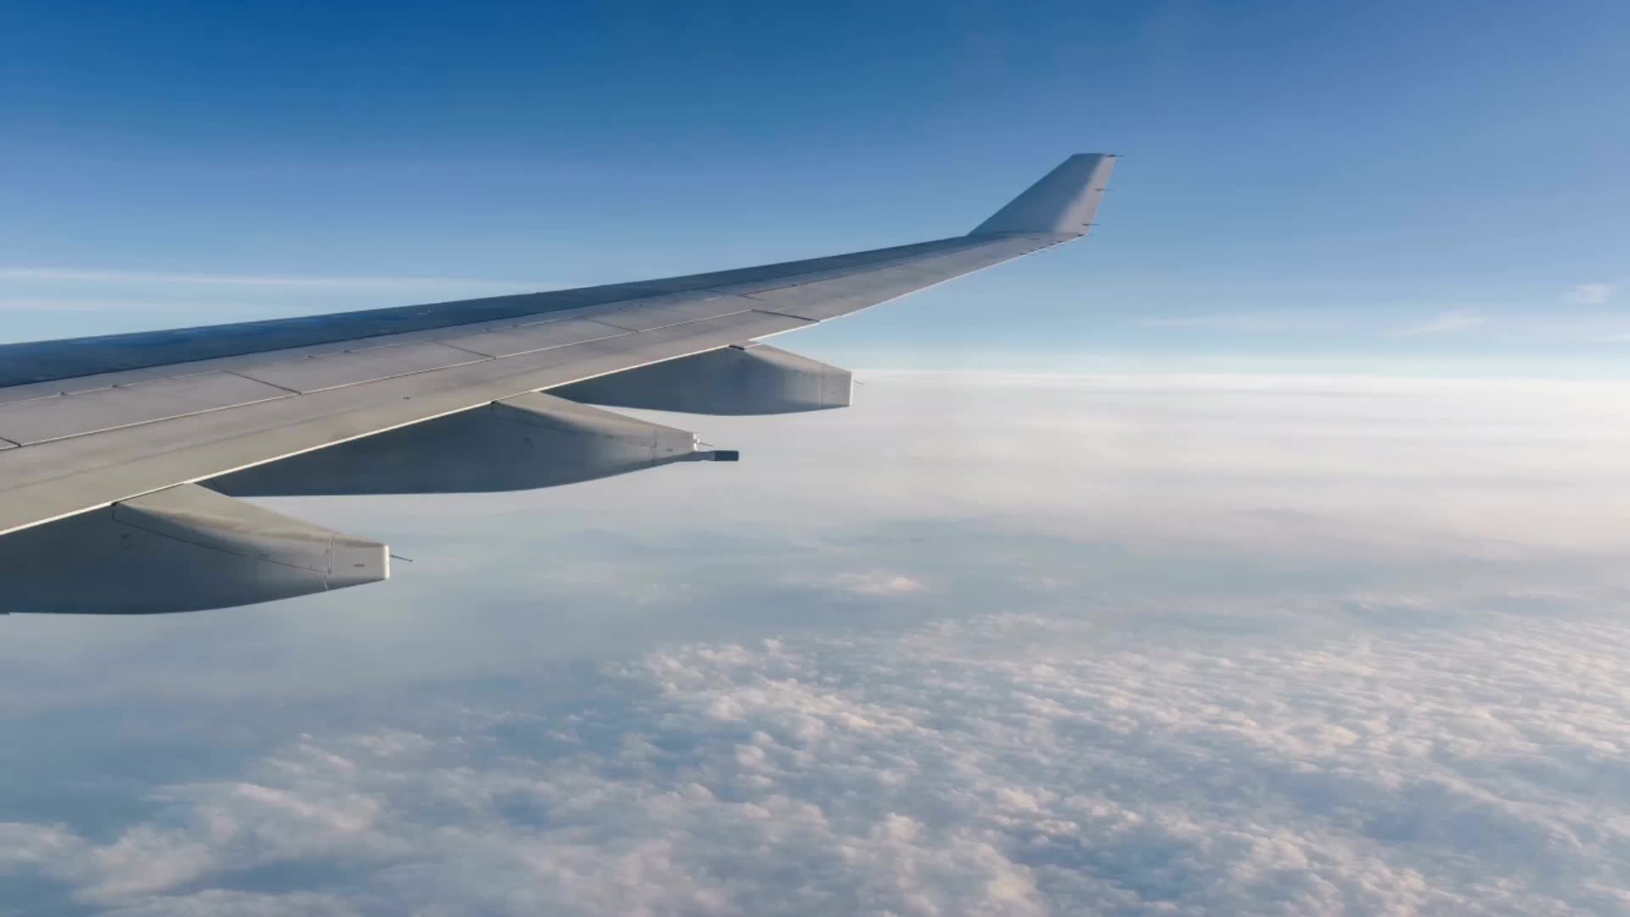
Boeing Cabin Experience
- Amber Paige Webber - Cole Donovan - Nicholas Mooney - Win Todd -

Slide 2


NDA Acknowledgement

Slide 3
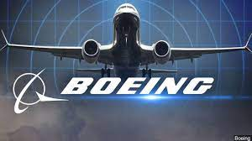
Project Overview SSA FTA Documentation

Slide 4
Work Accomplished
Constructed the Service Simulator Application(APIs) to stand in for Boeing’s proprietary software.
Built a Flight Test application web app that allows for more streamlined troubleshooting, error parsing, and report gathering.
Assembled a tech stack that allows quick start up and expandability.
Provided comprehensive documentation that will allow other developers to expand the system.

Slide 5
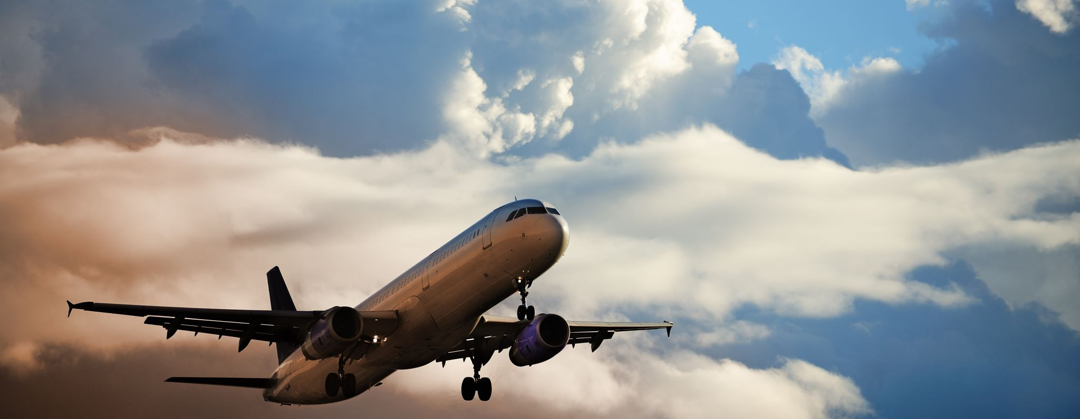
Flight Test Application Demo

Slide 6
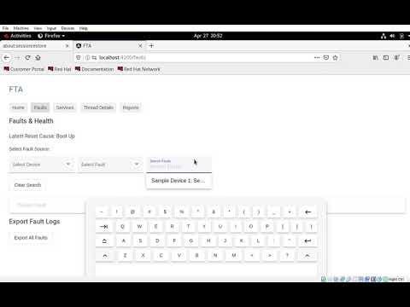

Slide 7
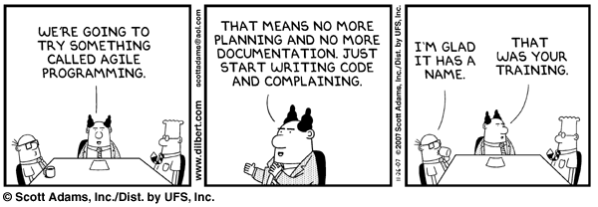
Documentation

Slide 8
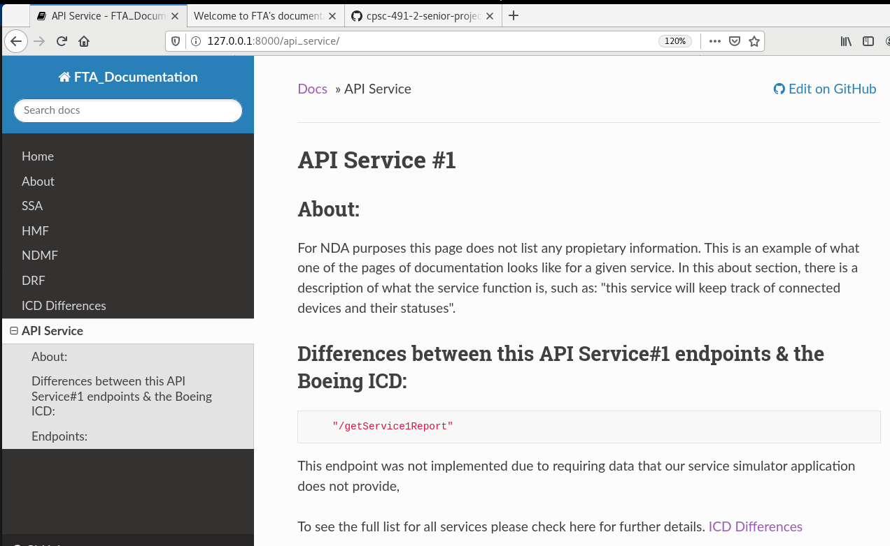
Name of the Service
Easy to Nav Bar
Describes the function of the service

Slide 9
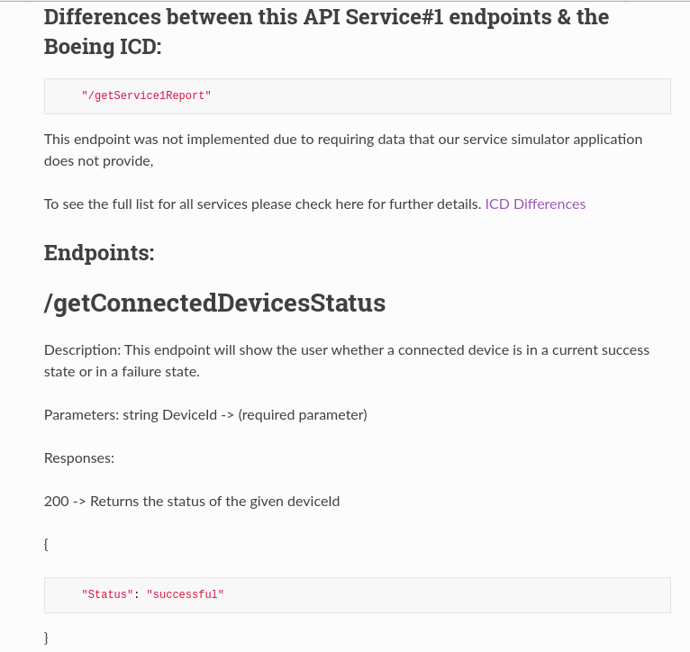
Endpoint & reason it was changed or not implemented
All endpoints for Service #1 listed, details include description, parameters, and sample JSON responses

Slide 10
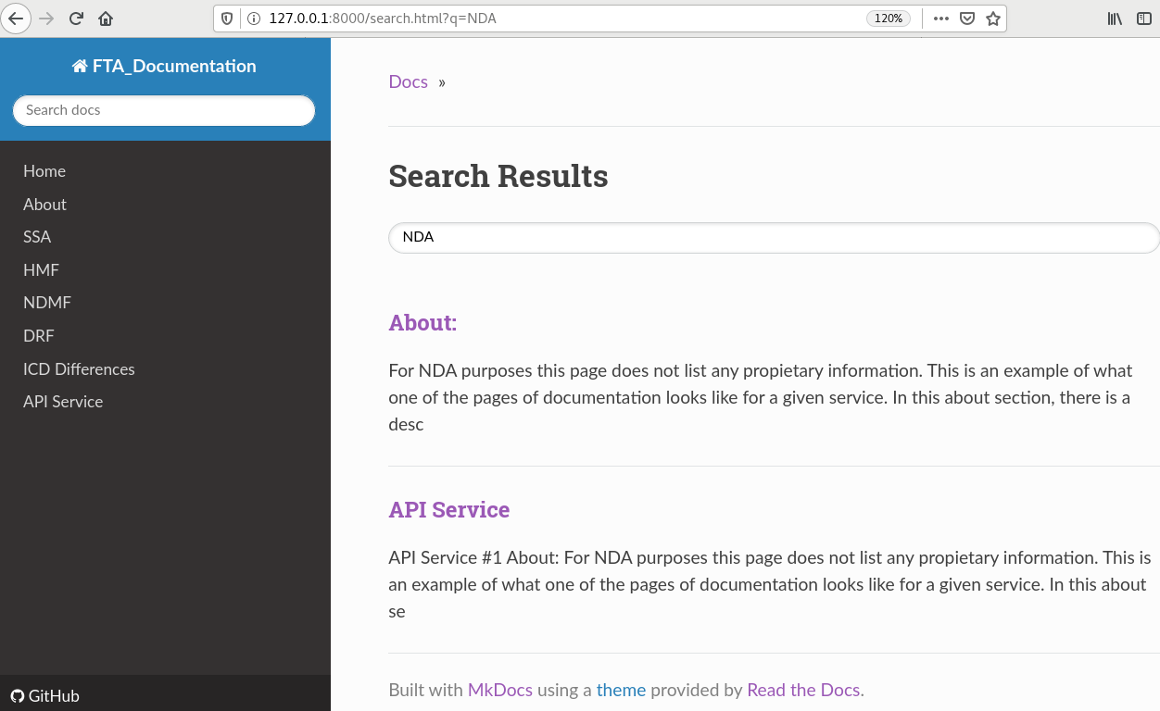
Using the search bar, we end up at the search results page
GitHub link, links the repo with this documentation for easy accessibility

Slide 11
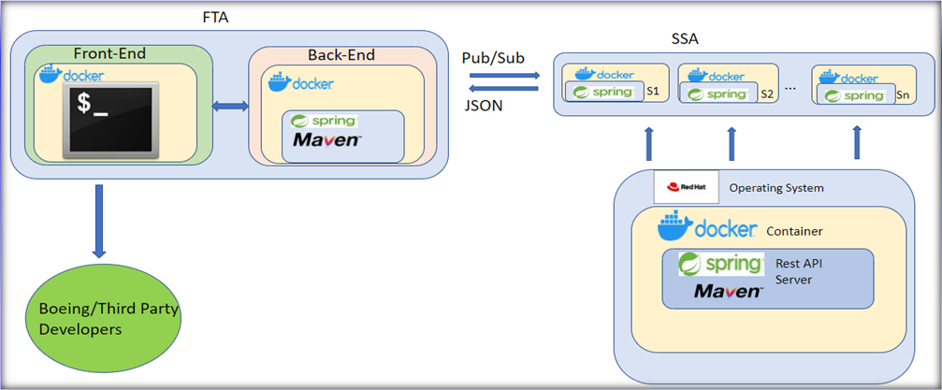

The Tech Stack

Slide 12



Major Technological Challenges
Slow start due to project FTA being dependent on SSA
Cross container communications
VM envrionment difficulty

Slide 13

System Evaluation

Slide 14
Usability Testing
Overview
Designated Script
Signed Consent Forms
Scrubbed Version of FTA Provided
5 Participants
5 Tasks
Results
Time frames varied from our expected times to complete tasks
Minimal guidance needed
Being unfamiliar with some terms was accurately predicted

Slide 15
Other Tests...
Smoke Tests
Unit Tests
Integration Tests
For example, a smoke test may address basic questions like "does the program run?", "does the user interface open?", or "does clicking the main button do anything?"
Unit Tests isolate a section of code and verify its correctness. A unit may be an individual function, method, procedure, module, or object.
Integration tests determine if independently developed units of software work correctly when they are connected to each other.

Slide 16
Modifications
Certain requirements (SRS's) had to be changed or deferred.
In addition, certain minor changes to the SSA were implemented.
All changes are tracked in our documentation.

Slide 17
Deployment
Docker Containers
Docker-Compose

Slide 18
Additional Considerations
Work Remaining
Maintenance
Change reverts
Integration in Boeing systems
Updates to Boeing systems must be mirrored

Slide 19

Lessons Learned
Have requirements clear and correct from the beginning
The importance of maintaining and integrating the tech stack

Slide 20

Questions

